Slide 1

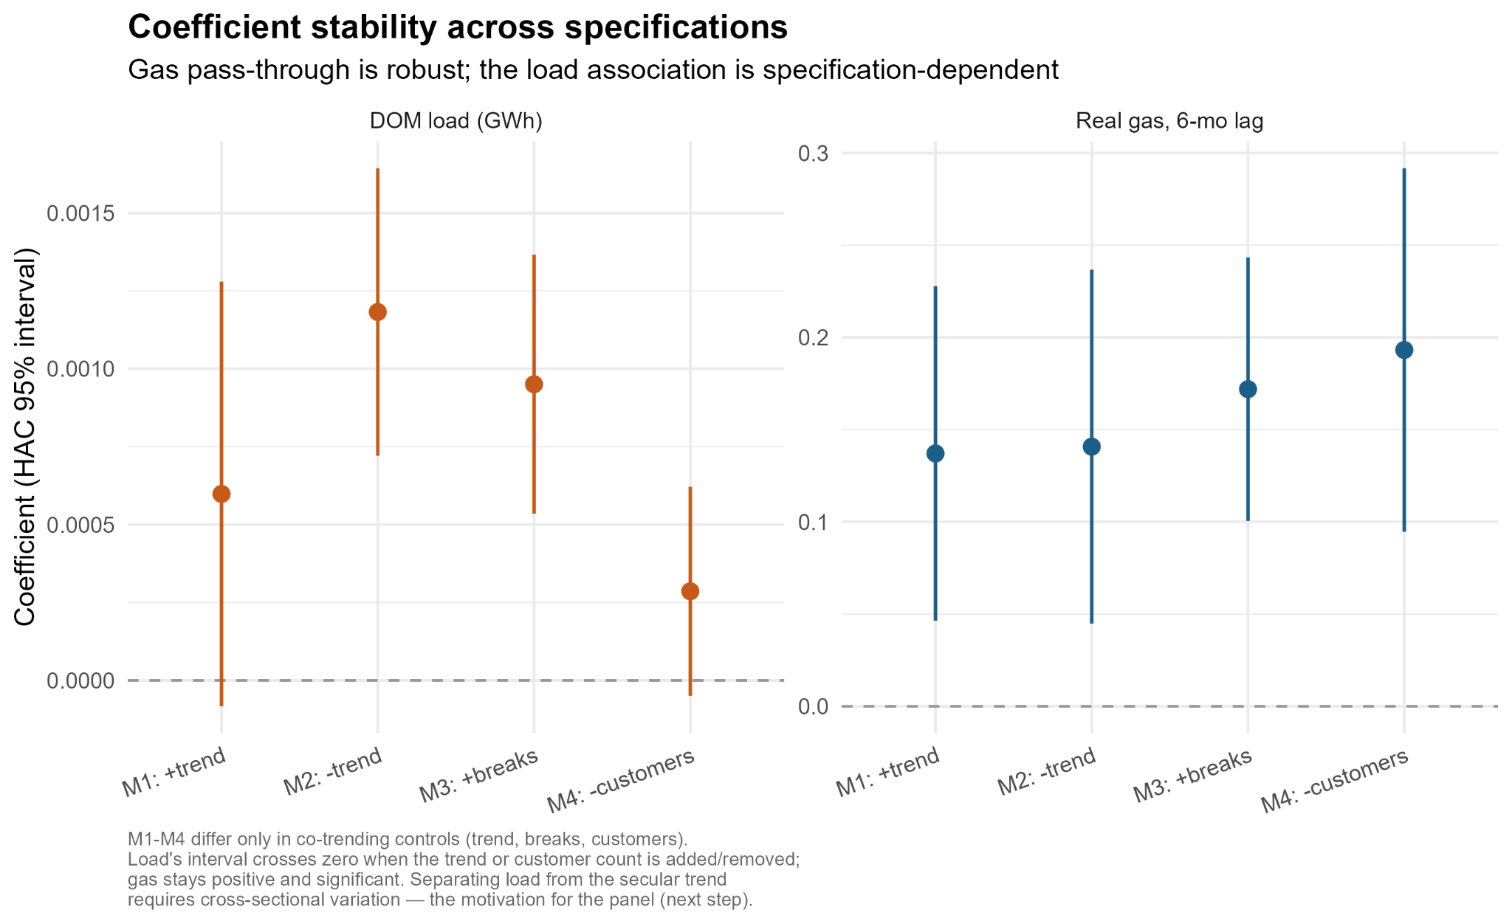
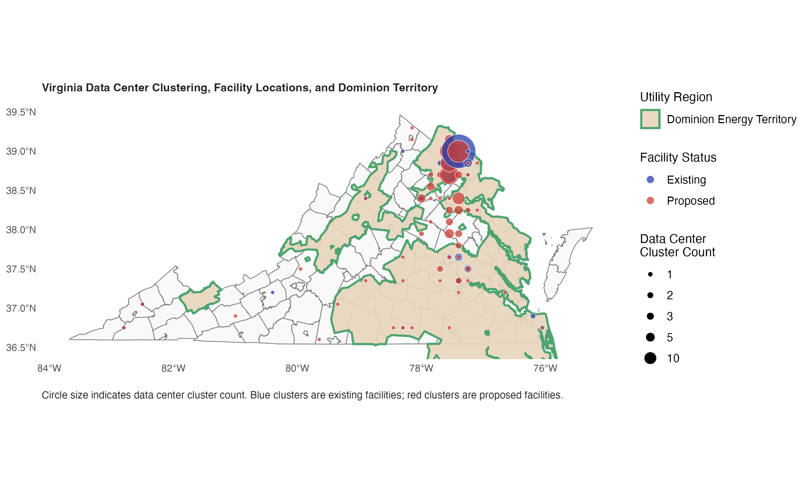
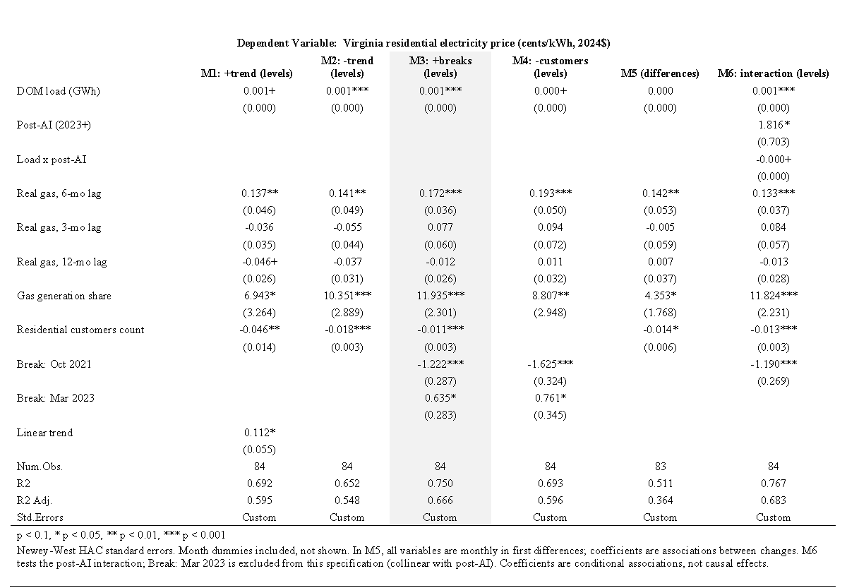
Summer Undergraduate Research Conference (SURC), Friday, July 24th, 2026
Data Center Load & Virginia Residential Electricity Prices (2018-2025)
Faculty Leader: Dr. Hélène Nguemgaing
Vijay Hong, Claire Olotara, Tarun Tammali
BACKGROUND
To estimate the relationship between data center-driven electricity demand and residential electricity prices, this study uses time-series analysis
1) Level Specification:
P_{t} = β₀ + β₁ G_{t−6} + β₂ L_{t} + β₃ B1_{t} + β₄ B2_{t} + X_{t} γ + δ_{m} mon_{m(t)} + λ trend_{t} + ε_{t}
Estimates change in:
Lagged natural gas price, G_{t−6} (real Henry Hub, $/MMBtu, 6-month lag)
Electricity load, L_{t} (DOM zone monthly load, GWh)
Structural breaks, B1_{t} and B2_{t} (indicators for Oct. 2021 and Mar. 2023)
Seasonality and trend: mon_{m(t)} (month fixed effects), trend_{t} (linear time trend)
Load × Post interaction, L_{t} × Post_{t} (M6 only; Post_{t} = 1 from Jan. 2023)
2) First-Difference Model:
Δ P_{t} = β₀ + β₁ Δ G_{t−6} + β₂ Δ L_{t} +X_{t} γ + ε_{t}
Examines whether short-term changes in electricity demand and fuel prices are associated with residential electricity prices after removing long-term trends.
Controls, X_{t} (HDD, CDD, residential customer counts, gas generation share)
Figure 2 shows the coefficient stability across alternative models. Point estimates and 95% HAC confidence intervals compare the DOM electricity load (GWh) against a 6-month lag of real natural gas prices across models M1 to M4.
Virginia rates are set through the State Corporation Commission (SCC) proceedings; gas costs are reflected in bills only after fuel-factor filling approval, which could explain why the load effect is hard to detect.
Fuel shares sum to one, so only the gas share, the price relevant to marginal fuel, is included in the main model; adding solar and wind shares leaves the results unchanged.
A single state’s series cannot isolate load from trend; a multi-state panel, contrasting data-center-heavy states with others, is the design that can, and this study’s results define exactly what it must test.
Residential electricity affordability is a live policy concern, and Virginia hosts the world’s largest data center market. Whether this new demand is reflected in household bills or absorbed elsewhere in the system is what regulators and consumers need to know.
Data center demand has grown rapidly with the expansion of cloud computing and the Internet of Things (Koot & Wijnhoven, 2021), accelerating further after the late-2022 AI boom.
Virginia, particularly Loudoun and Prince William counties in the Dominion (DOM) zone, has become one of the world’s largest data center markets, increasing electricity demand sharply.
Existing work examines wholesale market effects (Kay et al., 2026; Wiser et al., 2025); the retail side, where households actually pay, remains understudied.
RESEARCH QUESTION
Figure 2: Coefficient Stability Across Specifications
Do the electricity demands of Virginia’s data centers show up in residential electricity bills, and has that relationship changed since the late-2022 AI boom?
DATA & METHODS
RESULTS
Empirical models take data from the Energy Information Administration (EIA) and PJM Data Miner, with monthly average residential retail electricity prices being our variable of study.
Explanatory variables include DOM load and natural gas prices as the main variables, along with Heating Degree Days (HDD), Cooling Degree Days (CDD), residential customer counts, gas generation share, and month fixed effects as controls.
DOM zone load tracks Virginia total retail sales closely (Pearson r = 0.97), validating its use as a proxy for statewide demand.
Figure 1 illustrates the geographic distribution of existing and proposed data centers across Virginia within the DOM, the largest PJM zone in the state, taken from ArcGIS and Cleanview Data Center Tracker.
Real Virginia residential electricity prices are associated with natural gas costs at approximately a six-month lag (0.19, p < 0.001), consistent with regulated fuel-factor and rate-case timing. The association with DOM zone load is positive but cannot be cleanly separated from the secular time trend, and it shows no detectable change after the late-2022 AI expansion.
DOM Load has a statistically significant association with residential retail electricity prices in Models 2, 3, and 6 (β = 0.001, p <0.001), but becomes insignificant in Models 1, 4, and 5, suggesting that the association is sensitive to the model (Table 1).
Figure 2: Coefficient Stability Across Specifications
Table 1: Specification ladder: Virginia residential price
M1-M4 differ only in co-trending controls (trend, breaks, customers). Load’s interval crosses zero when the trend or customer count is added/removed; gas stays positive and significant. Separating load from the secular trend requires cross-sectional variation, which motivates the use of a panel in the next step.
Figure 1: Virginia Data Centers Facilities and Dominion (DOM) Zone
Prices track gas costs at approximately a six-month lag; the delay is built into SCC fuel-factor and rate-case timing, and the major price shifts of 2021-2023 coincide with the gas price cycle, not data center growth.
The load-price association cannot be separated from the general time trend, and it did not measurably change after the late-2022 AI expansion.
SELECTED REFERENCES
Koot, M., & Wijnhoven, F. (2021). Usage impact on data center electricity needs: A system dynamic forecasting model. Applied Energy, 291, 116798. https://doi.org/10.1016/j.apenergy.2021.116798
Kay, O., Reaser, R., & Taylor, R. (2026). Processing Power: The Effect of Data Centers on Wholesale Electricity Markets. Federal Reserve Bank of Dallas, Working Papers, 2026(2606). https://doi.org/10.24149/wp2606
Wiser, R., O’Shaughnessy, E., Barbose, G., Cappers, P., & Gorman, W. (2025). Factors Influencing Recent Trends in Retail Electricity Prices in the United States (SSRN Scholarly Paper No. 5337664). Social Science Research Network. https://doi.org/10.2139/ssrn.5337664
This map is descriptive; it is not evidence that data centers raised residential prices.
Gas lags of 3, 6, and 12 months were tested; the 3- and 12-month lags are jointly insignificant (F = 1.20, p = 0.31), and the 6-month lag fits best among 6-, 8-, and 9-month alternatives (AIC 108.8 vs. 126.1, 125.6), though cross-correlation suggests the timing is approximate.
Augmented Dickey-Fuller (ADF) and Kwiatkowski–Phillips–Schmidt–Shin (KPSS) tests confirm the series contains unit roots in levels and are stationary in differences, motivating the first-difference model and underlying why load cannot be separated from the trend.
Both dates coincide with the natural gas price cycle rather than the data center load ramp: October 2021 falls at the onset of the 2021- 2022 gas price surge, and March 2023 at its unwind.
M3 (break-controlled, 6-month gas lag) is our preferred specification for the level relationships: it replaces an arbitrary linear trend with structural break dates located empirically, and it retains only the gas lag supported by specification testing.
M5 (first differences) serves as a robustness check against non-stationarity. M6 tests whether the load-price association changed after the AI-driven expansion.
The break coefficients are level shifts in the real price (-1.22 cents/kWh in October 2021 and +0.63 cents/kWh in March 2023), not changes in the load-price relationship.
ACKNOWLEDGEMENTS
This research was supported by the Immersive Research Internship Experience program at the University of Maryland.
We thank the faculty leader, Dr. Hélène Nguemgaing, and our faculty collaborators. Special thanks to all our team members: Vijay Hong, Class of 2027, B.S. Statistics; Claire Olotara, Class of 2027, B.A. Economics, and Tarun Tammali, Class of 2027, B.S. Computer Science for the hard work and contribution to this project.

Slide 2
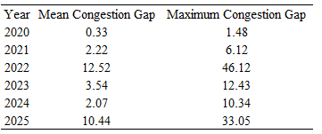
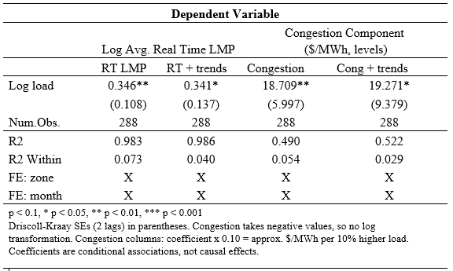
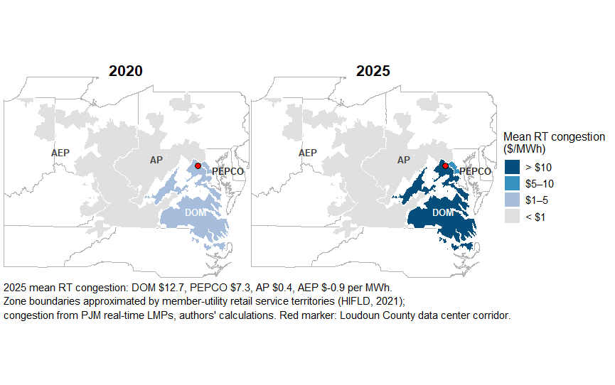
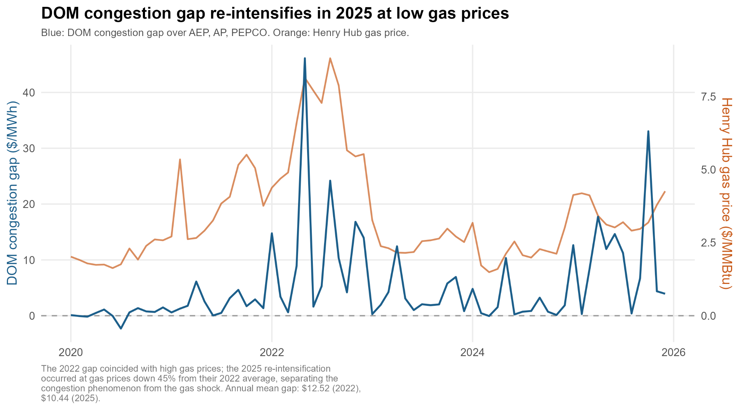

Summer Undergraduate Research Conference (SURC), Friday, July 24th, 2026
Powering AI: Data Center Load and Wholesale Electricity Price in PJM, 2020-2025
Faculty Leader: Dr. Hélène Nguemgaing
Daniel Ribeiro, Akshay Varma, Jordan Xiong
BACKGROUND
RESULTS
DOM’s congestion gap rises from $0.33/MWh (2020) to $12.52 (2022) and re-intensifies to $10.44 in 2025 at gas prices 45% below their 2022 average (Figure 2, Table 2). The pattern is not explained by the gas shock.
The adjacency contrast is the identifying comparison: a common regional shock would raise congestion in all peer zones; a transmission mechanism concentrates it in the adjacent zone, which is what we find (p < 0.001).
The rapid expansion of artificial intelligence and cloud computing has triggered an unprecedented demand for power, fundamentally shifting how wholesale energy markets operate. As explored by Kay et al. (2026), the entry of these massive, price-inelastic loads significantly alters local market dynamics and wholesale electricity pricing
Rather than being evenly distributed, these energy-intensive facilities are clustered. Chia et al. (2026) highlight this highly concentrated spatial distribution pattern on regional grid infrastructures
When the physical transmission grid cannot keep pace with localized demand surges, severe congestion follows. Prior work links this congestion to localized price premiums for consumers near major data hub centers (Mamkhezri et al., 2026)
Moving from pooled OLS to two-way fixed effects shifts the load coefficient from ≈ 0 to 0.35; most of the raw load-price correlation reflects zone differences and common shocks (full ladder in manuscript).
A 10% higher monthly load within a zone is associated with ~3.5% higher real-time prices (Table 1), robust to zone-specific trends (0.341, p < 0.05).
The association concentrates on congestion, the locally determined part of the price (~$1.87/MWh per 10% load); system-wide components track gas prices, with pass-through near complete.
Table 2: DOM congestion gap vs. comparison zones ($/MWh)
RESEARCH QUESTIONS
Table 1: Load associations: real-time LMP and congestion
Is growth in electricity demand, used as a proxy for AI-driven hyperscale data center expansion, associated with changes in wholesale electricity prices within PJM’s Dominion (DOM) transmission zone?
Are these associations also observed in neighboring transmission zones (AEP, AP, and PEPCO), suggesting possible spillover effects across the PJM transmission network?
DATA & METHODS
Gap = DOM monthly congestion minus AEP/AP/PEPCO mean
Monthly panel dataset tracking 4 PJM zones (DOM, AEP, AP, PEPCO) from Jan 2020 to Dec 2025
Hourly Locational Marginal Prices (LMPs) and metered loads aggregated to monthly averages from PJM Data Miner 2 (logs are taken of the monthly averages); weather is NOAA (LCD station files) and fuel mix from the EIA; Henry Hub natural gas prices from FRED.
Higher zone load is associated with higher wholesale prices, and the association lives almost entirely in transmission congestion, the part of the price paid where the grid is strained.
Congestion costs in the Dominion zone, home to the Northern Virginia data center corridor, pulled away from comparison zones after 2021 and reached $10.44/MWh above them in 2025, even with gas prices 45% below their 2022 peak.
Dominion’s load is associated with congestion in adjacent PEPCO but not in distant zones, the geographic signature of transmission constraints, and a cost that neighboring consumers share.
Figure 1: PJM Zone level congestion 2020 vs 2025
Gas-price pass-through is 0.97 (SE 0.05), with full one-for-one pass-through. Common gas-driven shocks move all zones together, so zone-specific signals appear in congestion.
SELECTED REFERENCES
Bogmans, C., Gomez-Gonzalez, P., Melina, G., Pescatori, A., & Thube, S. (2025). Power Hungry: How AI Will Drive Energy Demand.
Kay, O., Reaser, R., & Taylor, R. (2026). Processing Power: The Effect of Data Centers on Wholesale Electricity Markets. Federal Reserve Bank of Dallas, Working Papers, 2026(2606). https://doi.org/10.24149/wp2606
Shehabi, A., Smith, S. J., Masanet, E., & Koomey, J. (2018). Data center growth in the United States: Decoupling the demand for services from electricity use. Environmental Research Letters, 13(12), 124030. https://doi.org/10.1088/1748-9326/aaec9c
Han, Y., Shi, J., Yang, Y., & Wang, Y. (2019). Direct Rebound Effect for Electricity Consumption of Urban Residents in China Based on the Spatial Spillover Effect. Energies, 12(11), 2069. https://doi.org/10.3390/en12112069
Figure 2: DOM congestion gap vs Henry Hub gas price, 2020-2025
Our Two-Way Fixed Effects (TWFE) model specification is as follows:
⍺_{i}: zone fixed effects, capturing time-invariant characteristics of each zone (grid topology, baseline industrial mix).
γ_{t}: month-year fixed effects, which absorb shocks common to all zones in a given month (e.g., PJM-wide fuel cost, regional weather, federal rules).
X_{it} (supply and weather controls: HDD, CDD, generation shares, ln gas price); these controls are included in specifications without month-year fixed effects; in the Table 1 models, these are absorbed by γ_{t}.
β₁ represents the percentage change in wholesale prices associated with a 1% higher zone load.
Spillover: a companion model regresses each peer zone's congestion (AEP, AP, PEPCO) on DOM’s load, controlling for the peer’s own load, gas prices, weather, and fuel shares; an interaction tests whether the association differs for adjacent PEPCO vs. distant zones.
ACKNOWLEDGMENTS
This research was supported by the Immersive Research Internship Experience program at the University of Maryland.
We thank our faculty leader, Dr. Hélène Nguemgaing, our faculty collaborators, and the 2026 SURC committee for organizing this conference. Special thanks to our team members: Akshay Varma, Class of 2027, B.S. Information Science, Daniel Ribeiro, Class of 2028, B.S. Economics Major, and Jordan Xiong, Class of 2027, B.S. Information Science, for all their hard work and contribution to the project.
The 2022 gap coincided with high gas prices; the 2025 re-intensification occurred at gas prices down 45% from their 2022 average, separating the congestion phenomenon from the gas shock. Annual mean gap: $12.52 (2022), $10.44 (2025).

